Slide 1
Live Chat New channel to service our consumers
LeeAnn Sapp, Program Manager, Consolidated Services Center
Charles Mensah, Director, Project Management Office (PMO)

Slide 2



Live Chat Overview
“Live Chat” is an online platform which connects consumers from Flora to a live agent at the call center in real-time. MHBE implemented this platform on August 2, 2021, allowing CSRs to chat online with consumers before the high-volume OE period.
Customer Service Values
An additional communication channel to support our consumers
Caters to the population preferring "Online" interaction
Easy to provide consumers with information like weblinks, forms
Ability to support multiple consumers at the same time
Provides connected consumer experience
Improves wait times at the Call Center

Slide 3








Live Chat through "Flora"
Chat with AI Bot Flora
Consumer
General Questions
Account Specific Support
"Live" Agent

Slide 4

Major features at glance - Consumer
Initiate chat with an Agent from Flora
Chat for general information
Chat for account specific information
Verify identity through Login ID/Password
Verify identity answering questions
Provide feedback about chat
Download / Email chat transcript

Slide 5

Major features for Agents
Service a chat from the waiting list
Answer general information questions
Answer account specific information
Ability to send canned messages
Auto Responders
Ability to tag conversations
Ability to share documents / links
Ability to transfer chat to supervisor
Other functions to facilitate chat

Slide 6





Major features for Users
 | Role | Chat | Dashboard
 | CSR Agent
 | Supervisor
 | Management Team (Call Center Managers, MHBE Manager and QC Executives)

Slide 7






Live Chat – Comparison with SBMs
 | Support Hours | General | Account Specific | Login | Verification Questions
 | Mon - Fri
 | Mon & Tue
 | Mon – Fri

Slide 8

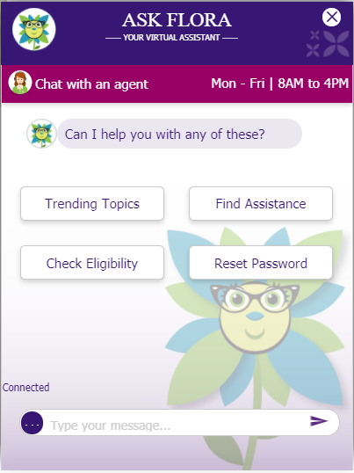
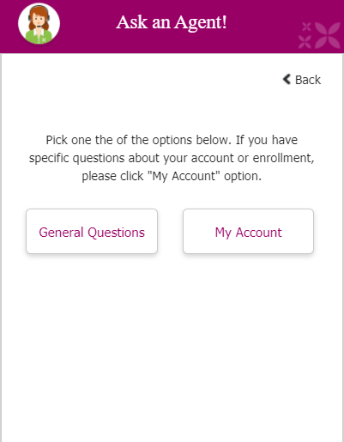
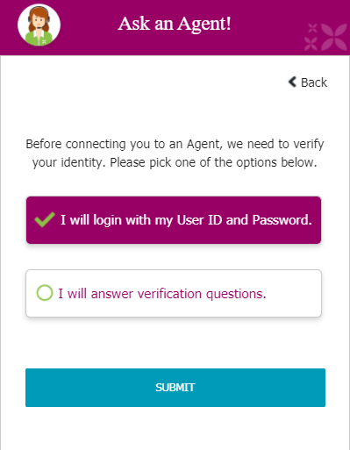
Consumer Experience

Slide 9
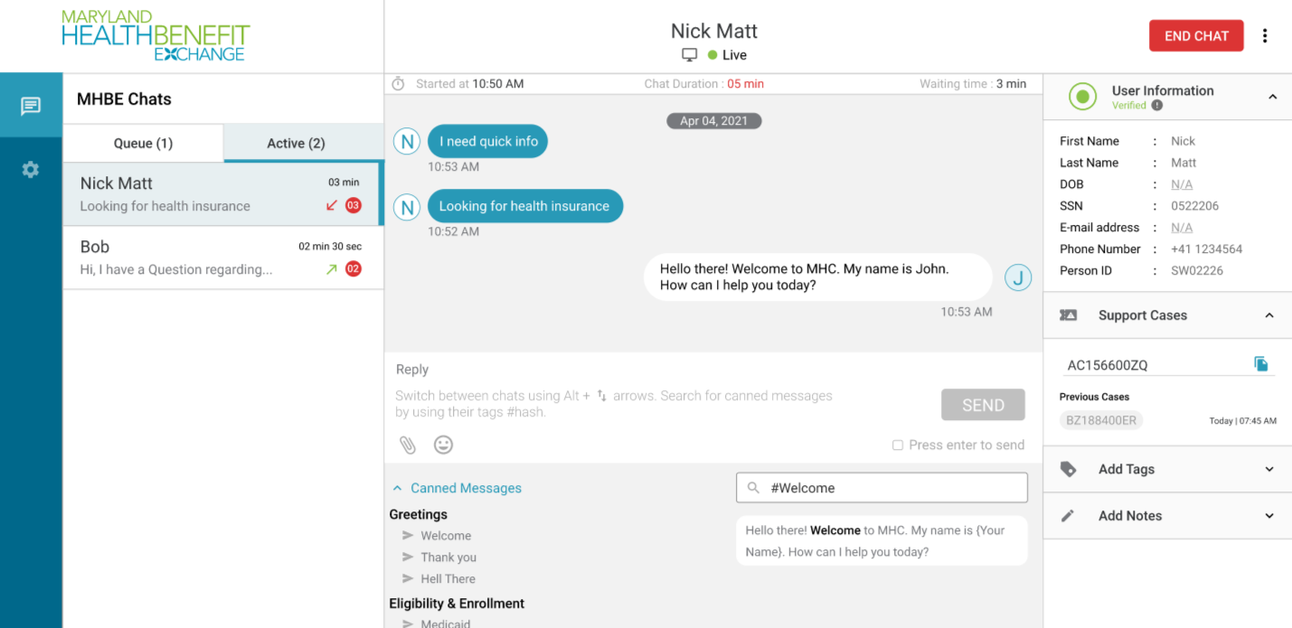
Agent View

Slide 10
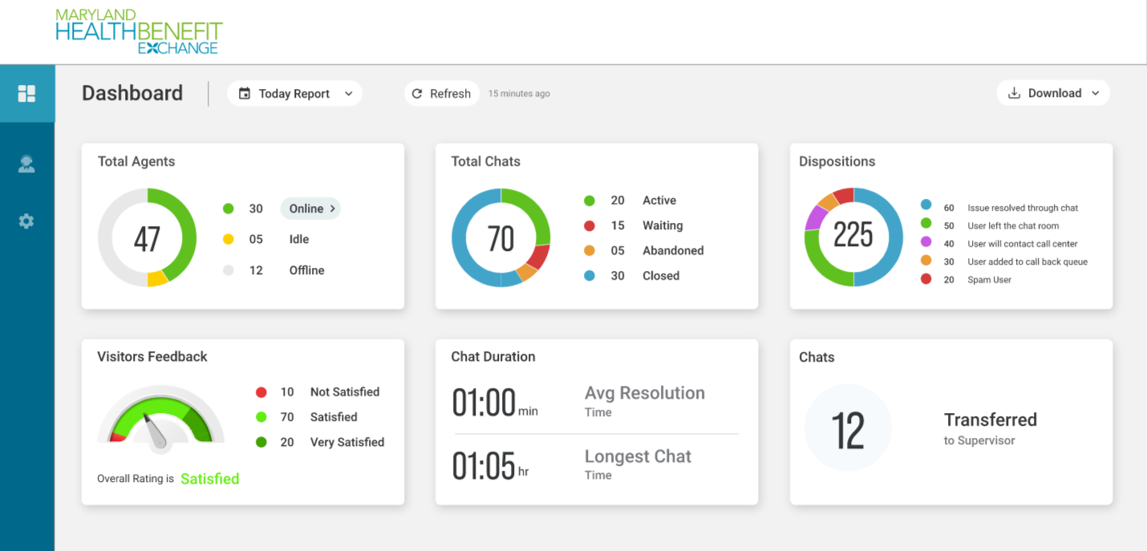
Dashboard
For illustration purpose only. Not actual data
15
5
0
85
20
10
1
10
100
200
15
10:00min
1
43:00min

Slide 11
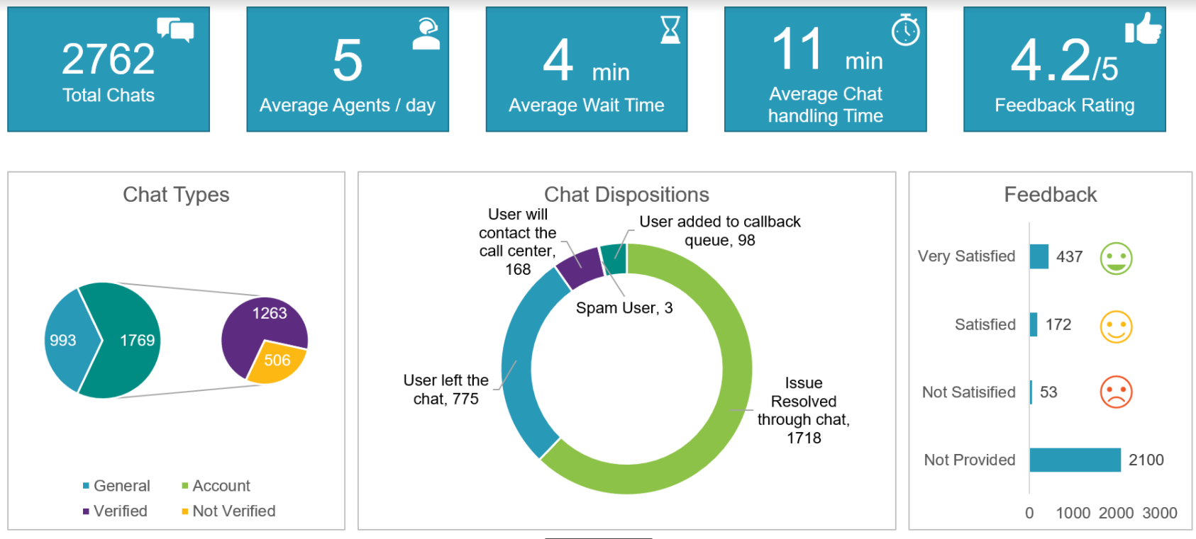
Live Chat Statistics – Aug 2 to Sep 17

Slide 12
Next Steps
Pilot: Aug - Dec 2021 is a pilot period with Maximus to evaluate demand, staffing, ongoing improvements in process and application.
Enhancement: Agents are supporting one chat at a time. We are looking to provide the ability to support two or more simultaneous chats in the future.
More Enhancements:
Live Chat from the Consumer Portal as a logged in user
Create case from Live Chat
Dashboard enhancements

Slide 13
Thank You

