Slide 1
MHBE Board Meeting
September 20, 2021
IT Procurement
Presented by:
Venkat R. Koshanam, CIO, MHBE
Raelene Glasgow, Procurement Officer, MHBE

Slide 2
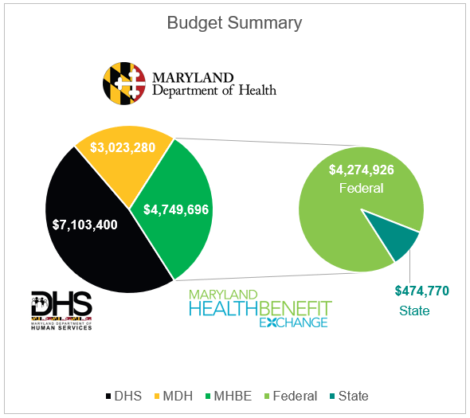
As-Needed APDu* to meet CMS CAP**
MHBE Work:
Single point of data collection and data sharing
Seamless consumer transfer between MAGI & Non-MAGI Medicaid for eligibility determination
Consumer Account restructuring and Security
Integrating with MD THINK Master Data Management (MDM)
Eliminating Interim Database (IDB)
Enhancements to Exchange Portals (Consumer Portal, Worker Portal, Stakeholder site, Chatbot and other integrated systems)
Reporting
Training
*Advance Planning Document-updated
** Corrective Action Plan for seamless consumer experience seeking MAGI or Non-MAGI Medicaid

Slide 3
Increase in FY 2022 IDIQ Budget
Work Category | Federal / State (%) | Federal Amount ($) | State Amount ($) | Total Amount ($)
Development, Enhancements, PMO | 90/10 | 11,642,400 | 3,057,600 | 14,700,000*
System Support, Maintenance & Operations | 75/25 | 8,065,530 | 4,154,970 | 12,220,500*
SHOP Development | 100% State | - | 752,021 | 752,021*
As-Needed APDu | 90/10 | 4,274,926 | 474,770 | 4,749,696**
Total Budget Amount |  | 23,982,856 | 8,439,361 | 32,422,217
* MHBE Board approved the FY 2022 IDIQ Not-to-exceed amount of $27,672,521 on 05/17/21
** As-Needed APDu submitted to CMS for approval

Slide 4
Request to Approve FY22 IDIQ Amount
MHBE requests the Board to approve an increase in the Not-to-exceed (NTE) amount for the IT Consulting and Technical Support Services IDIQ (Indefinite Delivery Indefinite Quantity) contracts by $4,749,696 to a new total NTE amount of $32,422,217 for the Fiscal Year 2022, with Federal Financial Participation amount of $23,982,856 and State Participation amount of $8,439,361.

Slide 5
Corticon License/Support Renewal
Background MHBE uses Corticon Business Rules Engine software for the end-to-end automation and management of Eligibility & Enrollment decision making functions of the Health Benefit Exchange (HBX) System.
Procurement Summary The License Renewal period (2 years) is from Aug 1, 2021 – July 31, 2023 Licensing Model: Maintenance/Support Renewal Procurement Method: Invitation for Bid (IFB) Number of Bids Received: Total 6 (2 were disqualified) Vendor Selected: vCloud Tech, Inc. FY21 cost of Corticon License renewal: $327,226.60 Total Cost of Corticon License renewal for two years: $694,115.33 First Year (FY22) Cost : $333,905.50 Second Year (FY23) Cost : $360,209.83

Slide 6
License Cost in FY 2022-2023
Product | Function | Federal 75% | State 25% | Total Cost
Corticon Studio | Windows-based standalone development environment for modeling, creating and testing business rules. This is where all business rules for various enrollment scenarios in use in the MHBE enrollment system get defined or created. | $458,116.12 | $235,999.21 | $694,115.33
Corticon Business Rules Server | Implements services and in-process servers for deploying business rules defined in the Corticon Studio. Execute the business rules based on the information entered by the consumers.

Slide 7
Request to Approve Contract Award
MHBE requests the Board to approve contract award to vCloud Tech, Inc. for an amount of $694,115.33 with Federal Financial Participation (FFP) amount of $458,116.12 and State Participation (SP) amount of $235,999.21 for the license renewal of Corticon Business Rules Engine for the period from August 1, 2021 to July 31, 2023.

