Slide 1
12 Takeaways from 2020 Open Enrollment
MHBE Board of Trustees Meeting
January 21, 2020

Slide 2
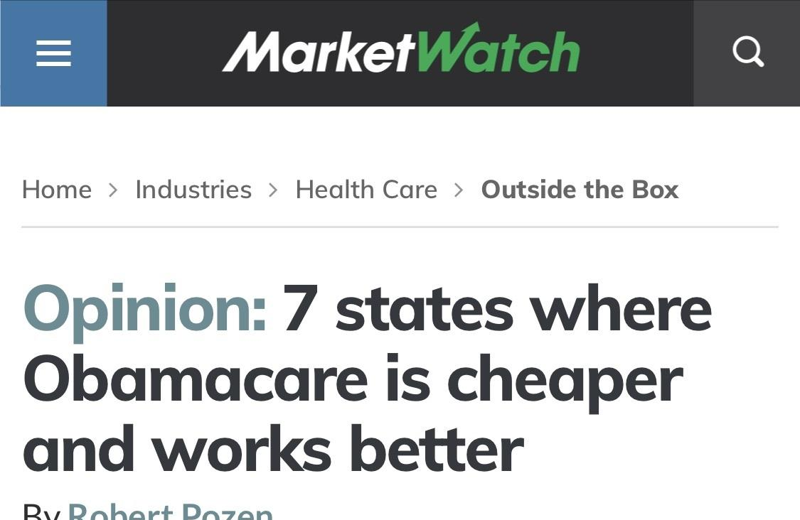
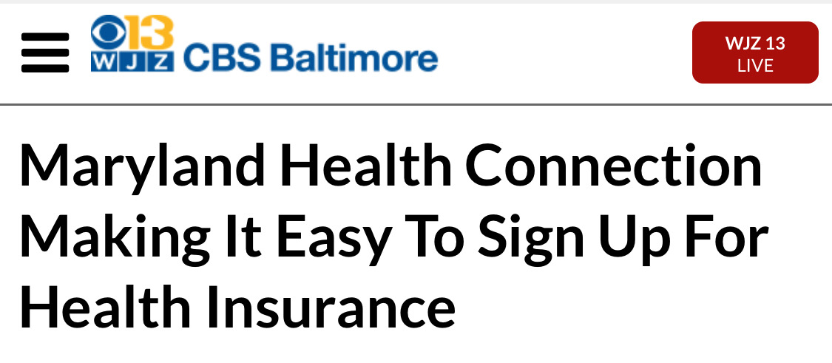
158,934
Md. +1%
215,484
Enrollment at four-year high
Compared favorably with early national numbers
Reinsurance continues to fortify total indiv. market
Dorchester +15%, Allegany +10%, Worcester +9%, Montgomery +1%
Anne Arundel -2%
HealthCare.gov -1.5% in preliminary count
Total on/off-exchange also up 1% from 212,149 a year earlier
14 states, including Md., have reported growth for 2020 so far
Some state exchanges still in open enrollment. Final #s by March

Slide 3


82,000
Market shift
Going for Gold
Private plan enrollments facilitated with assistance
Lower premiums led to lower deductibles. Enrollment not only held steady; many upgraded.
CareFirst at 61% of QHP market, up from 53% in 2019
1/2 of 2020 qualified health plans assisted, down from 70% + prior years
CareFirst gained 16%
Kaiser declined 16%
Platinum (1,955) up 13%
Gold (55,421) up 27%
Call Center: 15,000 QHPs
Navigators (129): 18,500 QHPs
Brokers (400): 49,000 QHPs
Silver (63,364) -15%
Bronze (34,445) +3%
Catastrophic (3,415) -2%

Slide 4
Target groups
Social growth
More familiar,
More favorable
Enrollments down slightly
65,000 social media engagements in Q4 2019
Shifts in fed policy on penalty + “public charge” may have had impact but more analysis needed.
In survey this fall, 84% of 450 young adults familiar with MHC judged it favorably, up 23 pts from 2017. Among uninsured 18-34s, 2/3rds desire coverage
Growth fueled by YI influencers, Spanish content, navigator videos
Young adults -2%
African-Americans -1%
Hispanics -1%
Instagram: +78%
Linked In: +27%
Twitter: +3%
Facebook: +2%
MHBE won “Award of Excellence” for outreach from Public Relations Society of America

Slide 5
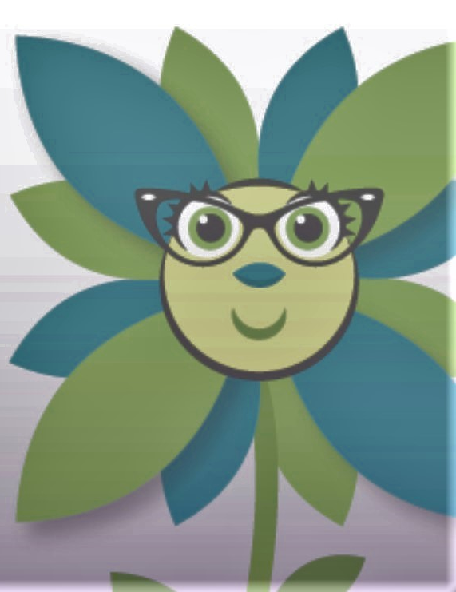
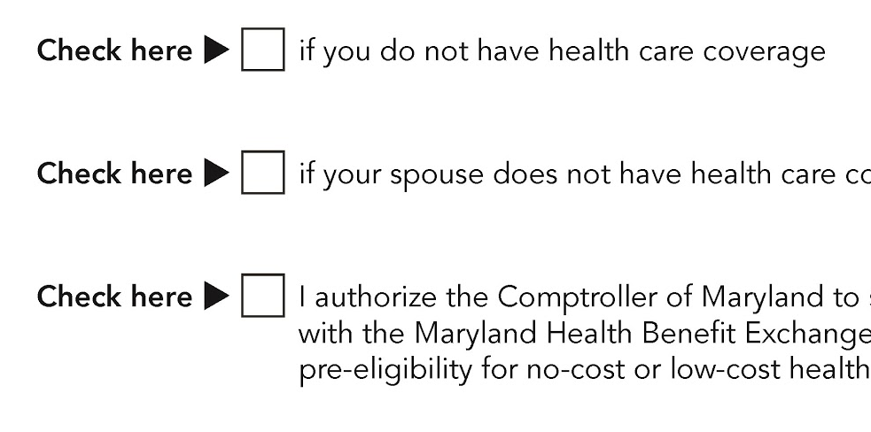
Mobile: The future is here
Easy Enrollment coming this winter
398,414
Mobile app use +24% Desktop visits -5%
1st of its kind in nation
Under 65 remain uninsured (est.)
State tax filers will check boxes if they lack coverage + want MHBE to receive that information.
400,000 Chatbot uses since launch
162,281 of them eligible for free or low-cost coverage (est.)
Top queries:
My account is locked
How do I upload documents?
Change MCO
Remaining 240,000 would not qualify for $ help for various reasons: HH income, citizenship, employer coverage offer

Slide 6
Andrew Ratner, Chief of Staff, 443-827-6558, aratner@maryland.gov

